Slide 1
Chapter 5: CPU Scheduling

Slide 2
Chapter 5: CPU Scheduling
Basic Concepts（基本概念）
Scheduling Criteria （调度准则）
Scheduling Algorithms（调度算法）
Thread Scheduling（线程调度）
Multiple-Processor Scheduling（多处理器调度）
Real-time Scheduling（实时调度）
Operating Systems Examples（例子）
Algorithm Evaluation（算法评估）

Slide 3
Objectives
To introduce CPU scheduling, which is the basis for multiprogrammed operating systems
To describe various CPU-scheduling algorithms
To discuss evaluation criteria for selecting a CPU-scheduling algorithm for a particular system

Slide 4
CPU Scheduling
Maximum CPU utilization obtained with multiprogramming
  As multiprogram running at the same time, they compete for resources, so scheduling is necessary, especially CPU.
CPU Scheduling is a fundamental OS function
  Every time a process has to wait, another process can take over use of CPU.

Slide 5
Basic Concepts
CPU-I/O Burst Cycle（脉冲周期）
CPU Scheduler（CPU调度器）
CPU Scheduling Scheme（调度方法）
CPU Dispatcher（调度程序）

Slide 6
CPU-I/O Burst Cycle
CPU–I/O Burst Cycle – Process execution consists of a cycle of CPU execution（CPU执行周期） and I/O wait（I/O等待周期）.
CPU burst distribution
  Usually, a large number of short CPU bursts and a small number of long CPU bursts
  An I/O-bound（I/O密集型） program typically has many short CPU bursts
  A CPU-bound（CPU密集型） program might have a few long CPU bursts.

Slide 7

Alternating Sequence of CPU And I/O Bursts

Slide 8

Histogram of CPU-burst Times

Slide 9
CPU Scheduler
许多进程都处于“就绪状态”，该选哪一个？
  Selects from among the processes in memory that are ready to execute, and allocates the CPU to one of them;
  Many processes in “ready” state;
  Which ready process to pick to run on the CPU?

Slide 10

CPU Scheduler
CPU scheduling decisions may take place when a process:
  Switches from running to waiting state
  Switches from running to ready state
  Switches from waiting to ready
  Terminates
Scheduling under 1 and 4 is nonpreemptive（非抢占）
All other scheduling is preemptive（抢占）
2
4
1
3

Slide 11
CPU Scheduling scheme
Nonpreemptive（非抢占式） Scheduling
  Once the CPU has been allocated to a process, the process keeps the CPU until it releases the CPU either by terminating or by switching to the waiting state.
Preemptive（抢占式） scheduling
  According to some rule, the CPU utilization of a process can be preempted .
    Timer
    Priority
    SJF

Slide 12
CPU Scheduling scheme
调度时机 | 原因 | 调度类型 | 必要性
运行 -> 等待 | 进程主动等待事件（如I/O） | 非抢占 | 必须调度（CPU空闲）
运行 -> 就绪 | 时间片用完或更高优先级进程就绪 | 抢占 | 必须调度（进程被强制中断）
等待 -> 就绪 | 等待的事件发生（如I/O完成） | 可能抢占 | 可能调度（取决于优先级）
进程终止 | 进程执行完毕或退出 | 非抢占 | 必须调度（CPU空闲）

Slide 13
Dispatcher
Dispatcher module gives control of the CPU to the process selected by the short-term scheduler; this involves:
  switching context
  switching to user mode
  jumping to the proper location in the user program to restart that program
Dispatch latency（调度延迟） – time it takes for the dispatcher to stop one process and start another running
  overhead

Slide 14
Chapter 5: CPU Scheduling
Basic Concepts
Scheduling Criteria
Scheduling Algorithms
Thread Scheduling
Multiple-Processor Scheduling
Real-time Scheduling
Operating Systems Examples
Algorithm Evaluation

Slide 15
Scheduling Criteria
CPU utilization（CPU利用率） – keep the CPU as busy as possible
Throughput（吞吐率） – # of processes that complete their execution per time unit
Turnaround time（周转时间） – amount of time to execute a particular process
Waiting time（等待时间） – amount of time a process has been waiting in the ready queue
Response time（响应时间） – amount of time it takes from when a request was submitted until the first response is produced, not output (for time-sharing environment)
周转时间=等待时间+执行时间

Slide 16
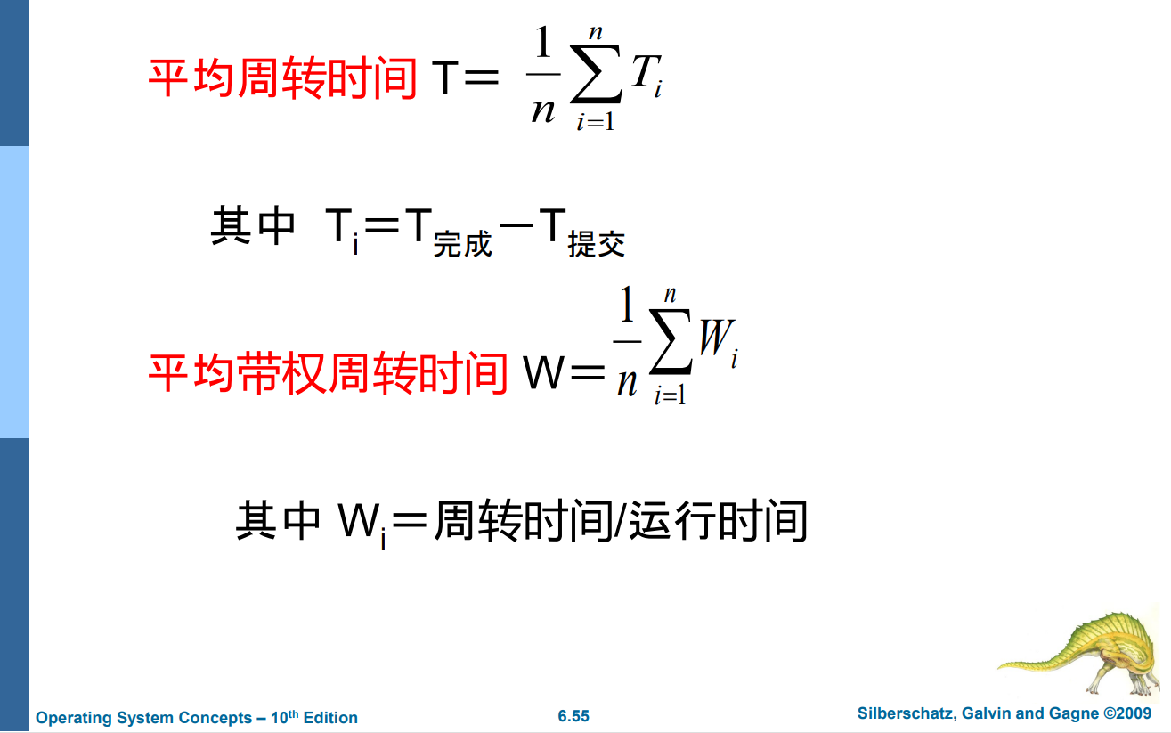
补充：衡量指标

Slide 17
Scheduling Algorithm Optimization Criteria
Max CPU utilization
Max throughput
Min turnaround time
Min waiting time
Min response time
Fairness: everyone makes progress, no one starves
“The perfect CPU scheduler”

Slide 18
Chapter 5: CPU Scheduling
Basic Concepts
Scheduling Criteria
Scheduling Algorithms
Thread Scheduling
Multiple-Processor Scheduling
Real-time Scheduling
Operating Systems Examples
Algorithm Evaluation

Slide 19
Scheduling Algorithm
FCFS
SJF
Priority scheduling
Round Robin (RR)
Multilevel Queue
Multilevel Feedback Queue

Slide 20
First-Come, First-Served (FCFS) Scheduling
FCFS（先来先服务） is the simplest CPU scheduling algorithm
The process that requests the CPU first is allocated the CPU first
Implementation:
  Manage with a FIFO queue
The average waiting time under the FCFS policy is often quite long.

Slide 21
First-Come, First-Served (FCFS) Scheduling
Process Burst Time
P₁ 24
P₂ 3
P₃ 3
Suppose that the processes arrive in the order: P₁ , P₂ , P₃
The Gantt Chart for the schedule is:
Waiting time for P₁ = 0; P₂ = 24; P₃ = 27
Average waiting time: (0 + 24 + 27)/3 = 17
P₁
P₂
P₃
0
24
27
30

Slide 22
FCFS Scheduling (Cont)
Suppose that the processes arrive in the order
P₂ , P₃ , P₁
The Gantt chart for the schedule is:
Waiting time for P₁ = 6; P₂ = 0; P₃ = 3
Average waiting time: (6 + 0 + 3)/3 = 3
Much better than previous case
P₂
P₃
P₁
0
3
6
30

Slide 23
Shortest-Job-First (SJF) Scheduling
Associate with each process the length of its next CPU burst. Use these lengths to schedule the process with the shortest time
SJF（短作业优先） is optimal – gives minimum average waiting time for a given set of processes.
  The difficulty is knowing the length of the next CPU request

Slide 24
Shortest-Job-First (SJF) Scheduling
Two schemes:
  nonpreemptive – once CPU given to the process it can not be preempted until completes its CPU burst
  Preemptive – if a new process arrives with CPU burst length less than remaining time of currently executing process, preempt. This scheme is know as the Shortest-Remaining-Time-First (SRTF).

Slide 25
Example of Non-Preemptive SJF
Process Arrival Time Burst Time
P₁ 0.0 7
P₂ 2.0 4
P₃ 4.0 1
P₄ 5.0 4
SJF (non-preemptive)
Average waiting time = (0 + 6 + 3 + 7)/4 = 4
P₁
P₃
P₂
P₄
0
3
7
8
12
16

Slide 26
Example of Preemptive SJF
Process Arrival Time Burst Time
P₁ 0.0 7
P₂ 2.0 4
P₃ 4.0 1
P₄ 5.0 4
SJF (preemptive)
Average waiting time = (9 + 1 + 0 +2)/4 = 3
P₁
P₂
P₃
P₂
P₄
P₁
0
2
4
5
7
11
16

Slide 27


Determining Length of Next CPU Burst
Can only estimate the length (CPU BURST)
Can be done by using the length of previous CPU bursts, using exponential averaging

Slide 28
Examples of Exponential Averaging
α =0
  τ_{n+1} = τ_{n}
  Recent history does not count
α =1
  τ_{n+1} = α t_{n}
  Only the actual last CPU burst counts
If we expand the formula, we get:
    τ_{n+1} = α t_{n}+(1 - α)α t_{n} -1 + …
    +(1 - α )^{j} α t_{n} _{-j} + …
    +(1 - α )^{n +1} τ₀
Since both α and (1 - α) are less than or equal to 1, each successive term has less weight than its predecessor

Slide 29

Prediction of the Length of the Next CPU Burst
图中α =1/2, τ0=10
Notes:
此图中α =1/2, τ₀=10

Slide 30
Priority Scheduling（优先级调度）
A priority number (integer) is associated with each process
The CPU is allocated to the process with the highest priority (smallest integer ≡ highest priority)
  Preemptive
  nonpreemptive
SJF is a priority scheduling where priority is the predicted next CPU burst time

Slide 31
Priority Scheduling
Problem ≡ Starvation（饥饿） – low priority processes may never execute
An interesting example:
  At MIT, they found that a low-priority process submitted in 1967 had not yet been run when they shut down the IBM 7094 in 1973.
Solution ≡ Aging（老化） – increase the priority of the process waiting for a long time.

Slide 32
Priority Scheduling
OS Solutions to process starvation
  Decreasing priority & aging（优先级降低&老化）: the Unix approach
    Decrease priority of CPU-intense process
    Exponential averaging of CPU usage to slowly increase priority of blocked process
    p_pri=min{127，(p_cpu/16+PUSER+p_nice)},
  Priority Elevation（优先级提升）: Windows approach
    Increase priority of a thread on I/O completion
    System gives starved threads an extra burst
Notes:
其中PUSER是一个常数；p_nice是用户为自己的进程设定的优先权，它可以通过系统调用命令来加以设置。通常，由这个量反映用户进程工作任务的轻重缓急程度。一个进程的p_nice被设置后，若再要改变，则只能够让其增加；p_cpu是进程使用处理机的时间，它给出了一个进程使用处理机的情况。

Slide 33
Round Robin (RR：轮转)
Each process gets a small unit of CPU time (time quantum), usually 10-100 milliseconds. After this time has elapsed, the process is preempted and added to the end of the ready queue.
If there are n processes in the ready queue and the time quantum is q, then each process gets 1/n of the CPU time in chunks of at most q time units at once. No process waits more than (n-1)q time units.
Performance
  q large ⇒ FIFO
  q small ⇒ q must be large with respect to context switch, otherwise overhead is too high

Slide 34
Example of RR with Time Quantum = 4
Process Burst Time
P₁ 24
P₂ 3
P₃ 3
The Gantt chart is:
Typically, higher average turnaround than SJF, but better response
P₁
P₂
P₃
P₁
P₁
P₁
P₁
P₁
0
4
7
10
14
18
22
26
30

Slide 35

Time Quantum and Context Switch Time
Longer quantum yields shorter average turnaround time（平均周转时间）?

Slide 36

Turnaround Time Varies With The Time Quantum
Notes:
一

Slide 37
Time Quantum and Context Switch Time
Performance depends on length of the timeslice
  Context switching isn’t a free operation.
  If timeslice time is set too high
    attempting to amortize context switch cost, you get FCFS.
  If it’s set too low
    you’re spending all of your time context switching between threads.
  Timeslice frequently set to 10~100 milliseconds
  Context switches typically cost < 1 millisecond

Slide 38
Multilevel Queue（多级队列）
Ready queue is partitioned into separate queues:
e.g. foreground (interactive)
background (batch)
Each queue has its own scheduling algorithm
  foreground – RR
  background – FCFS
Scheduling must be done between the queues
  Fixed priority scheduling; (i.e., serve all from foreground then from background). Possibility of starvation.
  Time slice – each queue gets a certain amount of CPU time which it can schedule amongst its processes; i.e., 80% to foreground in RR, 20% to background in FCFS
Notes:
按

Slide 39
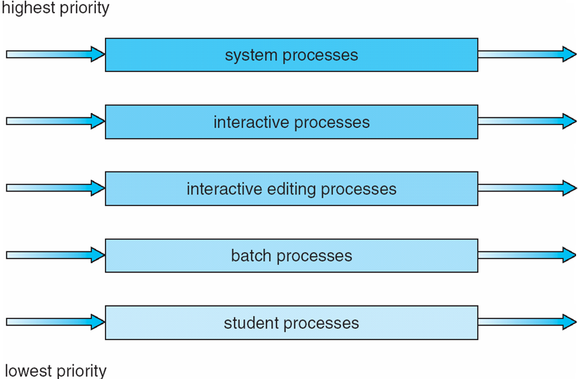
Multilevel Queue Scheduling

Slide 40
Multilevel Feedback Queue
多级反馈队列：
A process can move between the various queues; aging can be implemented this way
The idea is to separate processes with different CPU burst characteristics.
  If a process uses too much CPU time, it will be moved to a lower priority queue.
  If a process that waits too long in a lower priority queue may be moved to a higher priority queue.
Avoiding starvation.

Slide 41
Multilevel Feedback Queue
Multilevel-feedback-queue scheduler defined by the following parameters:
  number of queues（几个队列）
  scheduling algorithms for each queue（每个队列的调度算法）
  method used to determine when to upgrade a process（什么时候升优先级）
  method used to determine when to demote a process（什么时候降优先级）
  method used to determine which queue a process will enter when that process needs service（一开始选择哪个队列）

Slide 42
Example of Multilevel Feedback Queue
Four queues:
  Q₀ – RR with time quantum 2 milliseconds
  Q₁ – RR time quantum 4 milliseconds
  Q₂ – RR time quantum 8 milliseconds
  Q₃ – FCFS
Highest priority
Quantum = 2
Quantum = 4
Quantum = 8
FCFS
Lowest priority

Slide 43
A Multi-level System
I/O bound jobs
high
priority
CPU bound jobs
high
low
timeslice

Slide 44

调度算法 | 是否抢占 | 方法 | 特性
FCFS（先来先服务） | 非抢占 | 先请求CPU的进程首先分配到CPU | 平均等待时间往往很长
SJF（最短作业优先） | 抢占/ 非抢占 | 具有更短CPU执行的进程先执行 | SJF是最优的 困难的是如何知道下次CPU执行的程度
Priority scheduling （优先级调度） | 抢占/ 非抢占 | 具有最高优先级的进程会分配到CPU | 问题是无穷阻塞或饥饿 解决方案是老化
Round Robin （轮转调度) | 抢占 | 将一个较小时间单元定义为时间量/时间片，将定时器设置在一个时间片后中断 | 1.专门为分时系统设计 2.时间片应远大于上下文切换时间
Multilevel Queue （多级队列） | 看队列调度算法 | 将就绪队列分为多个单独队列，每个队列有自己的调度算法 | 1.前台进程可能要有更高的优先级 2. 进程永久分到一个队列
Multilevel Feedback Queue（多级反馈队列） | 抢占 | 允许进程在队列之间迁移 | 较低优先级队列中等待过程的进程会被移到更高优先级

Slide 45
补充：调度的分类
调度分为：
长程调度，又称作业调度，用于决定把外存上处于后备队列中的哪些作业调入内存，并为它们创建进程、分配必要的资源，然后，再将新创建的进程排在就绪队列上，准备执行
短程调度，又称进程调度，用来决定就绪队列中的哪个进程应获得处理机，然后再由分派程序把处理机分配给该进程的具体操作
中程调度，从就绪挂起到就绪，从阻塞挂起到阻塞，引入中程调度的主要目的，是为了提高内存利用率和系统吞吐量

Slide 46
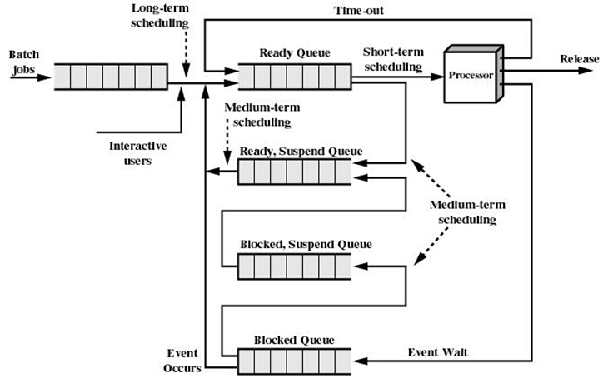
补充：调度的分类

Slide 47
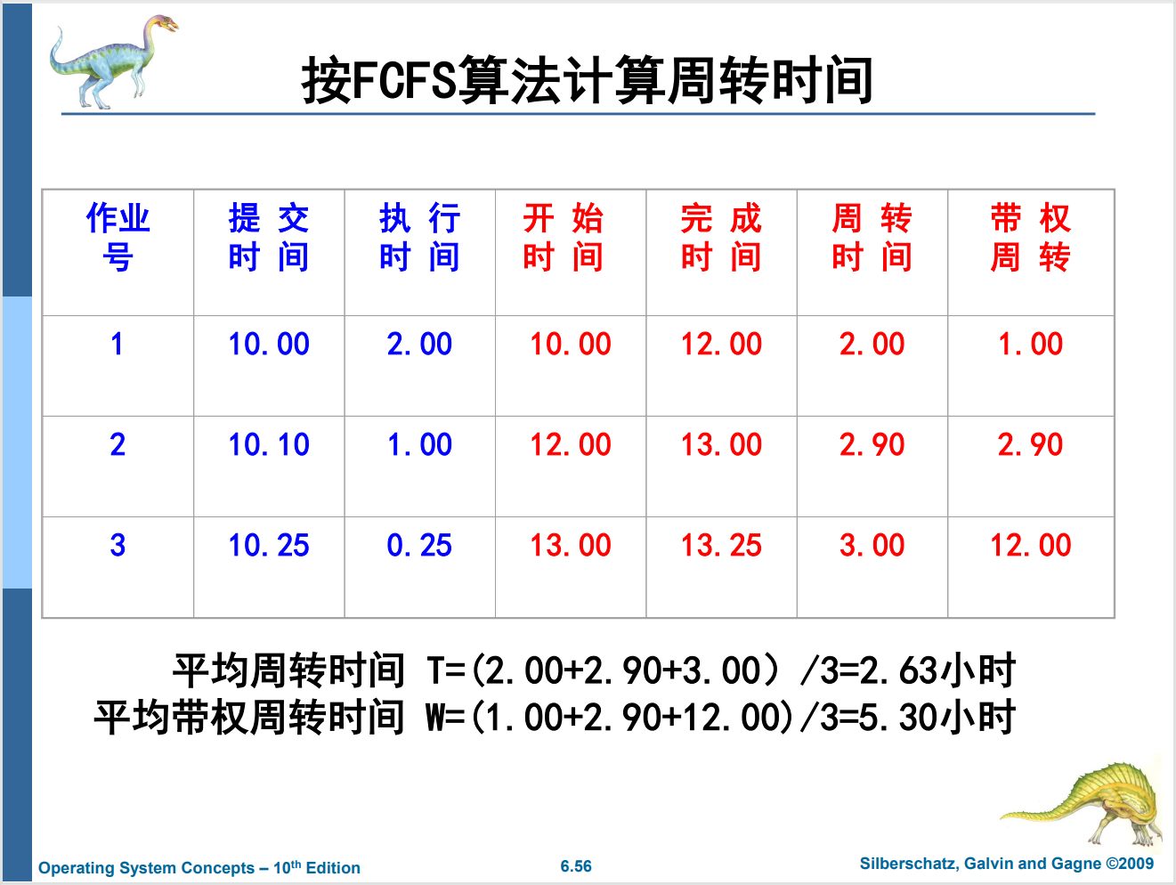

Slide 48
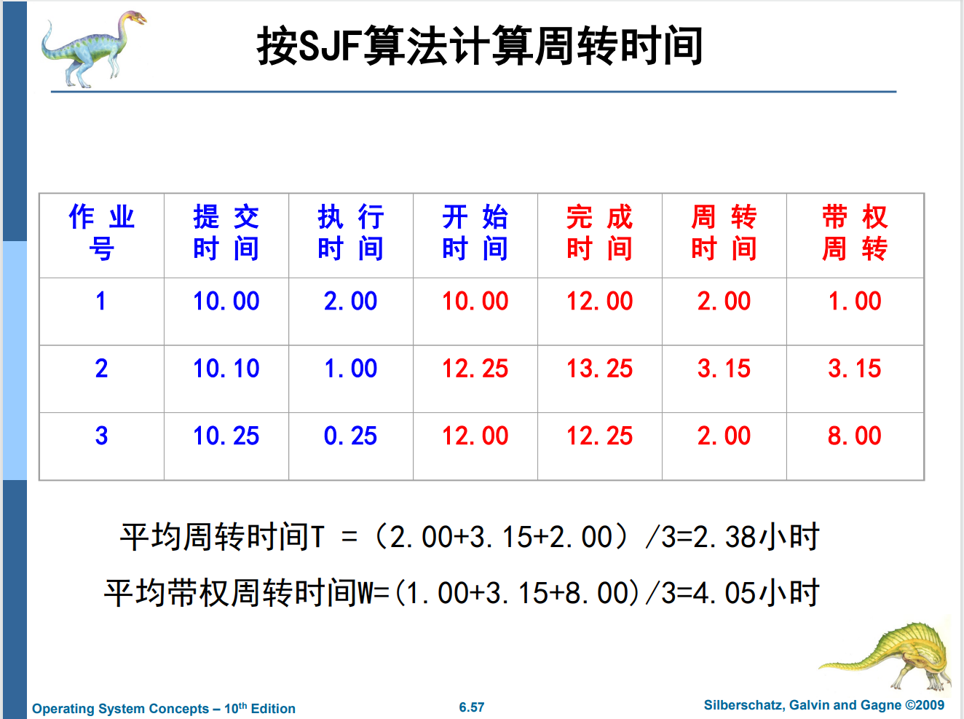

Slide 49
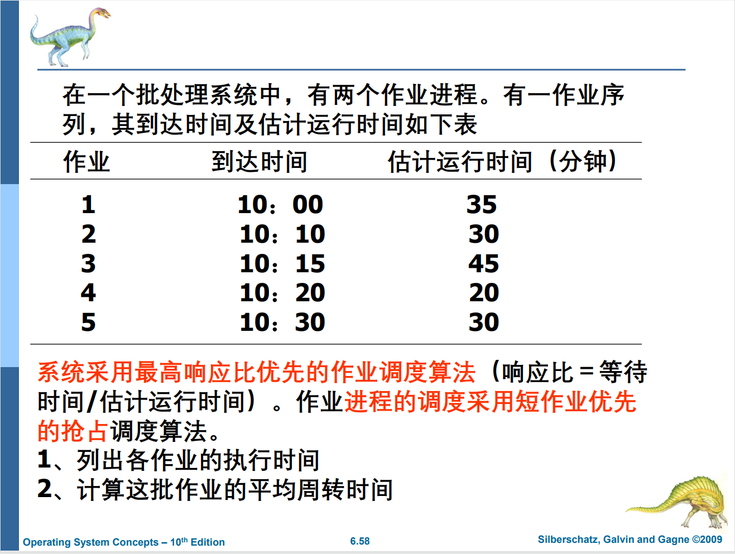
例题

Slide 50
Chapter 5: CPU Scheduling
Basic Concepts
Scheduling Criteria
Scheduling Algorithms
Thread Scheduling
Multiple-Processor Scheduling
Real-time Scheduling
Operating Systems Examples
Algorithm Evaluation

Slide 51
Thread Scheduling
Distinction between user-level and kernel-level threads
Many-to-one and many-to-many models, thread library schedules user-level threads to run on LWP
  Known as process-contention scope (PCS，进程竞争范围) since scheduling competition is within the process（发生在同一个进程内的线程之间）
Kernel thread scheduled onto available CPU is system-contention scope (SCS，系统竞争范围) – competition among all threads in system（发生在系统所有线程之间）
  Systems using the one-to-one model (such as Windows XP, Solaris 9, Linux) schedule threads using only SCS

Slide 52
Thread Scheduling
进程竞争范围（PCS, Process-Contention Scope）
  谁被调度？ 用户级线程（ULT）。
  由谁调度？ 应用程序的线程库（如 POSIX Pthreads 库）。
  在哪里竞争？ 在同一个进程内。线程库决定将哪个用户级线程分配到该进程所拥有的轻量级进程（LWP） 上运行。
系统竞争范围（SCS, System-Contention Scope）
  谁被调度？ 内核级线程（KLT）
  由谁调度？ 操作系统内核。
  在哪里竞争？ 在整个系统范围内。内核决定将哪个内核级线程（或哪个进程的 LWP）分配到物理 CPU 核心上执行。

Slide 53
Thread Scheduling
多对一模型（Many-to-One Model）
  PCS（线程库负责）： 线程库在进程内部调度多个 ULT，决定哪个 ULT 可以在这个唯一的 LWP 上运行。
  SCS（内核负责）： 内核将这个唯一的 LWP 当作一个普通的调度单元，与其他进程的 LWP/线程一起竞争 CPU 时间。
多对多模型（Many-to-Many Model）
  PCS（线程库负责）： 线程库在进程内部调度多个 ULT，决定哪个 ULT 可以分配到该进程所拥有的某个可用的 LWP 上运行。
  SCS（内核负责）： 内核将进程的这多个 LWP 分别调度到物理 CPU 核心上。这样，一个进程的多个 ULT 就可以通过不同的 LWP 真正地并发执行。
一对一模型（One-to-One Model）
  PCS 消失： 在这种模型中，应用程序的线程库不再负责线程调度。
  只有 SCS： 创建用户线程会直接创建一个对应的内核线程。该线程的调度完全由内核负责，与系统中所有其他线程平等竞争 CPU。

Slide 54
Pthread Scheduling
API allows specifying either PCS or SCS during thread creation
  PTHREAD SCOPE PROCESS schedules threads using PCS scheduling
    Schedules user-level threads onto available LWPs
  PTHREAD SCOPE SYSTEM schedules threads using SCS scheduling.
    Create and bind an LWP for each user-level thread on many-to-many systems, Mapping threads using one-to-one policy
Notes:
PTHREAD API 允许线程创建时指明其属性是PCS 还是SCS

Slide 55
Pthread Scheduling API
#include <pthread.h>
#include <stdio.h>
#define NUM THREADS 5
int main(int argc, char *argv[])
{
int i;
pthrea_t tid[NUM _THREADS];
pthread_attr_t attr;
/* get the default attributes */
pthread_attr_init(&attr);
/* set the scheduling algorithm to PROCESS or SYSTEM */
pthread_attr_setscope(&attr, PTHREAD SCOPE SYSTEM);
/* set the scheduling policy - FIFO, RT, or OTHER */
pthread_attr_setschedpolicy(&attr, SCHED OTHER);
/* create the threads */
for (i = 0; i < NUM THREADS; i++)
pthread create(&tid[i],&attr,runner,NULL);

Slide 56
Pthread Scheduling API
/* now join on each thread */
for (i = 0; i < NUM THREADS; i++)
pthread join(tid[i], NULL);
}
/* Each thread will begin control in this function */
void *runner(void *param)
{
printf("I am a thread\n");
pthread exit(0);
}

Slide 57
Chapter 5: CPU Scheduling
Basic Concepts
Scheduling Criteria
Scheduling Algorithms
Thread Scheduling
Multiple-Processor Scheduling
Real-time Scheduling
Operating Systems Examples
Algorithm Evaluation

Slide 58
Multiple-Processor Scheduling
CPU scheduling more complex when multiple CPUs are available（多处理器调度更夫咋说）
Homogeneous processors（同构多处理器） within a multiprocessor
Asymmetric multiprocessing（非对称多处理） – only one processor accesses the system data structures, alleviating the need for data sharing
Symmetric multiprocessing (SMP) （对称多处理）– each processor is self-scheduling
  all processes in common ready queue
  or each has its own private queue of ready processes
  In most modern OS supporting SMP, each processor has a private ready queue.

Slide 59
Multiple-Processor Scheduling
Processor affinity（处理器亲和性） – process has affinity for processor on which it is currently running
  soft affinity（软亲和性）
    OS has a policy of attempting to keep a process running on the same processor but not guaranteeing that it will do so
    It is possible for a process to migrate between processors
  hard affinity（硬亲和性）
    OS provides system calls allowing a process to specify that it is not to migrate to other processors

Slide 60
Multicore Processors
Recent trend to place multiple processor cores on same physical chip（在同一芯片上放置多核处理器）
Faster and consume less power
Multiple threads per core also growing
  Takes advantage of memory stall to make progress on another thread while memory retrieve happens(利用内存停顿，当发生内存检索时另一个线程运行)

Slide 61

Multithreaded Multicore System

Slide 62
例题
下列进程调度算法中，（ ）可能会出现进程饿死的情况。
A.非抢占式静态优先权法
B.抢占式静态优先权法
C.时间片轮转调度算法
D.非抢占式动态优先权法
答案：B

Slide 63
例题
【多选】下列选项中，（ ）可能是非抢占方式进程调度中引起调度的原因。
A.当前的运行进程调用阻塞原语而进入阻塞状态
B.当前的运行进程提出申请I/O而阻塞
C.有更高优先级的进程到达而从执行状态变为就绪状态
D.正在执行的进程执行了P原语操作，由于资源不足而阻塞
答案： ABD

Slide 64
例题
【多选】在多级队列调度和多级反馈队列调度的叙述中，正确的是（ ）。
A.多级反馈队列调度中就绪队列的设置不是像多级队列调度一样按作业性质划分，而是按时间片的大小划分
B.多级队列调度用到优先权，而多级反馈队列调度中没有用到优先权
C.多级队列调度中的进程固定在某一个队列中，而多级反馈队列调度中的进程不固定
D.多级队列调度中每个队列按作业性质不同而采用不同的调度算法，而多级反馈队列调度中除了个别队列外，均采用相同的调度算法
答案： ACD

Slide 65
例题
【简答】高级调度和低级调度的主要任务是什么？引入中级调度的目的是什么？
答案：
(1) 高级调度又称为作业调度。其主要任务是，按照某种算法从外存的后备队列上选择一个或多个作业调入内存，并为它们创建进程、分配必要的资源，然后再将创建的进程控制块挂入就绪队列上。
(2) 低级调度又称进程调度。其主要任务是，按照某种算法从就绪队列上选择一个（或多个）进程，使其获得CPU。
(3) 引入中级调度的目的是为了提高内存利用率和系统吞吐量。其功能是，让那些暂时不能运行的进程不再占用宝贵的内存资源，而是调出到外存上等待。此时的进程状态为挂起状态。当这些进程重新具备运行条件且内存空闲时，由中级调度选择一部分挂起状态的进程调入内存，将其状态变为内存就绪状态。

Slide 66
Chapter 5: CPU Scheduling
Basic Concepts
Scheduling Criteria
Scheduling Algorithms
Thread Scheduling
Multiple-Processor Scheduling
Real-time Scheduling
Operating Systems Examples
Algorithm Evaluation

Slide 67
Real time Scheduling
在这些系统中，系统的正确性不仅取决于计算的逻辑结果，而且还取决于产生结果的时间。
AI为你提供母语级高精翻译
Real-time systems（RTOS）（实时系统）
Those systems in which the correctness of the system depends not only on the logical result of computation, but also on the time at which the results are produced.
在这些系统中，系统的正确性不仅取决于计算的逻辑结果，而且还取决于产生结果的时间。

Slide 68
Real time Scheduling
Real time computing is of two types
  Heard real-time systems（硬实时系统）
    Requires to complete a critical task within a guaranteed amount of time
    Special-purpose systems
    failure to meet constraint is a fatal fault.
  Soft real-time systems（软实时系统）
    late completion is undesirable but generally not fatal.
    It requires that critical processes receive priority over less fortunate ones
    The result is a general-purpose system to support multimedia, high speed interactive graphics, and so on

Slide 69
Real time Scheduling
事件延迟：从事件发生到事件得到服务的这段时间
两种类型的延迟影响实时系统的性能：
  中断延迟：从CPU收到中断到中断处理程序开始的时间
    先完成正在执行的指令，再确定发生中断的类型
    中断延迟要有界
  调度延迟：调度程序从停止一个进程到启动另一个进程所需的时间量

Slide 70

Dispatch Latency
响应间隔：事件延迟
调度延迟
中断延迟
冲突
调度
Notes:
调度响应时间

Slide 71
Dispatch Latency
What happens if the higher priority process needs to access kernel data that are currently being accessed by another, lower priority process?（如果高优先级进程需要访问低优先级进程的数据怎么办？）
Priority inversion（优先级倒挂）: the higher-priority process would be waiting for the lower priority process to finish.
该现象可能引起严重后果. 例如,美国的火星探测器Mars Pathfinder就是因为优先级倒挂而出现故障.

Slide 72
Dispatch Latency
Solution to Priority inversion:
  Priority-inheritance protocol（优先级继承）
    The processes (accessing resources that the high-priority process needs) inherit the high priority until they are done with the resources in question.
  When they are finished, their priority reverts to its original value.

Slide 73
Task Management
Main service offered is Task Scheduling（任务调度）
  controls the execution of application software tasks
  can make them run in a very timely and responsive fashion.

Slide 74
Task Scheduling
Non Real -time systems usually use Non-preemptive Scheduling （非实时系统通常采用非抢占式调度）
  Once a task starts executing, it completes its full execution
Most RTOS perform priority-based preemptive task scheduling.（大多数RTOS执行基于优先级的抢占式任务调度）
Basic rules for priority based preemptive task scheduling
  The Highest Priority Task that is Ready to Run, will be the Task that Must be Running.

Slide 75
Task Switch
Each time the priority-based preemptive（基于优先级的抢占式调度） scheduler is alerted by an External world trigger / Software trigger
Task Switch步骤:
  Determine whether the currently running task should continue to run. （确定现在要运行的任务是否还要继续运行）
  Determine which task should run next.（确定哪个作业应当下一个运行）
  Save the environment of the task that was stopped (so it can continue later).（保存现场）
  Set up the running environment of the task that will run next.（设置运行环境）
  Allow the selected task to run.（运行选定的作业）

Slide 76
Real time Scheduling
Typical RTOS based on fixed-priority preemptive（固定优先级抢占） scheduler
Assign each process a priority
At any time, scheduler runs highest priority process ready to run, Higher Priority = Higher Need for Quick Response
Process runs to completion unless preempted
Follows nested preemption （支持嵌套抢占）

Slide 77
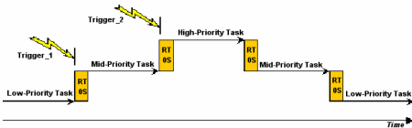
Nested Preemption
Timeline for Priority-based Preemptive Scheduling

Slide 78
Typical RTOS Task Model
Each task a triplet: (execution time执行时间, period周期, deadline截止时间)
Usually, deadline = period
Can be initiated any time during the period
Execution time
Deadline
Initiation
Time
Period

Slide 79
Real time Scheduling
Typical real-time scheduling algorithm
  RMS: rate monotonic scheduling（单调速率调度）
    Just one scalar priority related to the periodicity of the job（只有一个优先级，该优先级与作业的周期有关）
    Priority = 1/rate （优先级与速率成反比）
    Static（静态优先级）
  EDF: Earliest Deadline First（最早截止期限优先）
    Priority = deadline
    要求：进程需要告知截止时间
Notes:
最早截止任务优先算法(EDF: Earliest Deadline First)：以满足用户要求时限为调度原则。
处理开始时限（开始截止时间）
处理结束时限（完成截止时间）
最短周期优先算法(RMS:rate monotonic scheduling)：广泛用于多周期性实时处理。其基本原理是周期越长的任务优先级越低。

Slide 80
Rate-Monotonic Scheduling
Common way to assign priorities
Simple to understand and implement:
E.g.,
Processes with shorter period given higher priority
Period Priority
10 1 (highest)
12 2
15 3
20 4 (lowest)

Slide 81
Rate-Monotonic Scheduling
Always run the highest-priority runnable process
1
2
3
Notes:
最短周期优先

Slide 82
Earliest-Deadline-First (EDF) Scheduling
Preemptive & dynamically assigns priorities according to deadline（根据截止日期动态分配优先级）
  Earlier deadline, higher priority
  Later deadline, lower priority
Highest priority process available gets CPU

Slide 83
EDF Meeting a Deadline
p1 = (10,20,20) p2 = (15,30,30) utilization is 100%
1
2
P2 takes priority because its deadline is sooner

Slide 84
EDF Meeting a Deadline
p1 = (10,20,20) p2 = (15,30,30) utilization is 100%
1
2
P2 takes priority because its deadline is sooner

Slide 85
Chapter 5: CPU Scheduling
Basic Concepts
Scheduling Criteria
Scheduling Algorithms
Thread Scheduling
Multiple-Processor Scheduling
Real-time Scheduling
Operating Systems Examples
Algorithm Evaluation

Slide 86
Operating System Examples
Solaris scheduling
Windows XP scheduling
Linux scheduling

Slide 87
Solaris scheduling
Solaris uses priority-based thread scheduling.
It defines 4 classes of scheduling , in order of priority:
  Real time（实时）
  System（系统）
  Interactive（交互）
  Time sharing（分时）
Within each class there are different priorities and different scheduling algorithms.

Slide 88
Solaris scheduling
The default scheduling class is time sharing.
The scheduling policy for time sharing dynamically alters priorities and assigns time slices of different lengths using a multilevel feedback queue.（多级反馈队列动态改变优先级）
The interactive class uses the same scheduling policy as the time sharing class, but it gives windowing applications a higher priority for better performance.
Using system class to run kernel processes, such as the scheduler and paging daemon, the priority of a system process does not change.（使用系统类来运行内核进程，系统进程的优先级不会改变。）
Threads in real time class are given the highest priority.

Slide 89
Windows XP scheduling
Priority-driven, preemptive scheduling system（优先级、抢占）
Thread runs for time amount of quantum
Dispatcher routines triggered by the following events（由下列事件引起调度）:
  Thread becomes ready for execution（线程就绪）
  Thread leaves running state (quantum expires, wait state)（线程结束运行）
  Thread‘s priority changes（线程优先级转变）
Notes:
线程按时间片来使用CPU

Slide 90
Windows XP scheduling
Multiple threads may be ready to run
“Who gets to use the CPU?”
From Windows API point of view:
  Processes are given a priority class upon creation（进程在创建时被赋予一个优先级类）
    Idle, Below normal, Normal, Above normal, High, Realtime
  Threads have a relative priority within the class（线程在类中具有相对优先级）
    Idle, Lowest, Below_Normal, Normal, Above_Normal, Highest, and Time_Critical
Notes:
线程按时间片来使用CPU

Slide 91
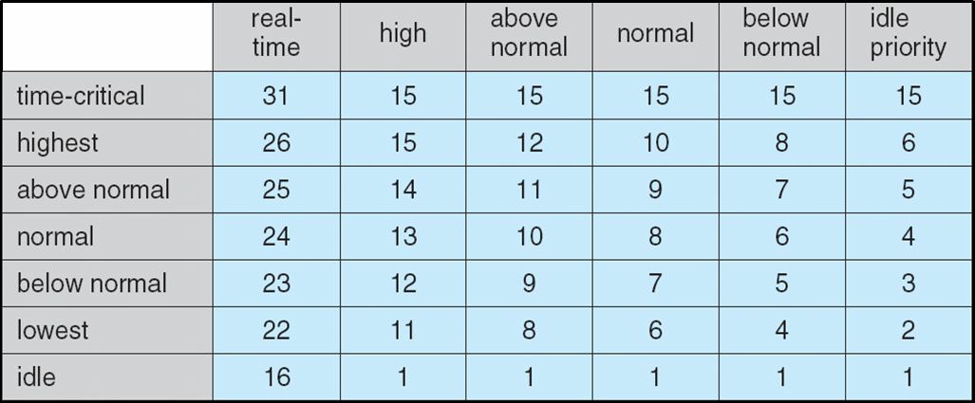
Windows XP Priorities
非实时任务
实时任务
可变类：优先级1-15
实时类：优先级16-31
值越大，优先级越高

Slide 92
Kernel: Thread Priority Levels
31
16
16 “real-time” levels
15
1
15 variable levels
Used by zero page thread
0

Slide 93
Windows XP Scheduling
From the kernel’s view:
  Threads have priorities 0 through 31
  Threads are scheduled, not processes（调度的是线程，不是进程）
  Process priority class is not used
  to make scheduling decisions（进程的优先级类不用于调度决策）

Slide 94
Windows XP Scheduling
32 priority levels
Threads within same priority are scheduled following the Round-Robin policy（具有相同优先级的线程按照轮转策略进行调度）
Non-Realtime Priorities are adjusted dynamically
Real-time priorities (i.e.; > 15) are assigned statically to threads

Slide 95
Priority Adjustments for Windows XP Threads
Five types:
  I/O completion
  Wait completion on events or semaphores
  When threads in the foreground process complete a wait
  When GUI threads wake up for windows input
  For CPU starvation avoidance
No automatic adjustments in “real-time” class (16 or above)
  “Real time” here really means “system won’t change the relative priorities of your real-time threads”
  Hence, scheduling is predictable with respect to other “real-time” threads (but not for absolute latency) （相对于其他线程，实时线程的调度是可预测的）

Slide 96
Linux Scheduling
The Linux scheduler is a preemptive, priority-based （优先级、抢占式）algorithm with two priority ranges: time-sharing and real-time
  Real-time range from 0 to 99
  nice value from 100 to 140
These two ranges map into a global priority scheme whereby numerically lower values indicate higher priority（数值越低，优先级越高）

Slide 97
Chapter 5: CPU Scheduling
Basic Concepts
Scheduling Criteria
Scheduling Algorithms
Thread Scheduling
Multiple-Processor Scheduling
Real-time Scheduling
Operating Systems Examples
Algorithm Evaluation

Slide 98
Algorithm Evaluation
How do we select a CPU scheduling algorithm for a particular system?
The first problem is defining the criteria（确定评估标准） to be used in selecting an algorithm. According to system goal :
  CPU utilization（最大化CPU使用率）
  Throughput（吞吐量）
  Average turnaround time（平均周转时间）
  Response time（响应时间）
Then select an algorithm
And then evaluate the algorithm selected

Slide 99
Algorithm Evaluation
Deterministic modeling （确定性建模）
  takes a particular predetermined workload and defines the performance of each algorithm for that workload
Queueing models（排队模型）
Simulations（仿真）
Implementation（实现）

Slide 100
Algorithm Evaluation
Queueing models（排队模型）
  The computer system is described as a network of servers.（计算机系统被描述为一个服务器网络）
  Each server has a queue of waiting processes.（每个服务器都有一个等待进程队列）
  The CPU is a server with its ready queue, and I/O system with device queues.（CPU是一个有就绪队列的服务器，而I/O系统是一个有设备队列的系统）
  Knowing arriving rates and service rates, we can compute utilization, average queue length, average wait time, and so on.（已知到达率和服务率，我们就可以计算利用率、平均队列长度、平均等待时间等等。）

Slide 101

Algorithm Evaluation
Queueing models（排队模型）
  E.g. let n be the average queue length（平均队列长度）, let w be the average waiting time in the queue（平均等待时间）, and let λ be the average arrival rate（平均到达率） for new processes in the queue

Slide 102
Algorithm Evaluation
Simulations（仿真）
  Programming a model of the computer system
    The simulator has a variable representing a clock（模拟器有一个表示时钟的变量）
    As the variable’s value is increased, the simulator modifies the system state to reflect the activity of the devices, the processes , and the scheduler.（模拟器修改系统状态以反映设备、进程和调度器的活动。）
  As the simulator executes, statistics that indicate algorithm performance are gathered and printed.（当模拟器执行时，将收集并打印表明算法性能的统计信息。）

Slide 103
Algorithm Evaluation
Implementation
  The only completely accurate way to evaluate a scheduling algorithm is to code it up, put it in the OS, and see how it works.（评估调度算法的唯一完全准确的方法是编写代码，把它放在操作系统中，然后看看它是如何工作的）

Slide 104
例题

Slide 105
例题答案
10:00 作业1到达，由于就绪队列空，作业调度进系统，进程调度执行
10:10 作业2到达，就绪队列未满，作业调度进系统，由于2此时是最短作业，所以进程调度1到就绪态，调度2执行。
作业1已运行10分钟，剩余25分钟
10:15 作业3到达，响应比为0，等待作业调度进系统
作业2继续执行，已运行5分钟，剩余25分钟
作业1剩余25分钟，位于就绪队列

Slide 106
例题答案
10:20 作业4到达，响应比为0，等待作业调度进系统
作业3等待5分钟，响应比R=5/45 = 0.11
作业2继续执行，已运行10分钟，剩余20分钟
作业1剩余25分钟，位于就绪队列
10:30 作业5到达，响应比为0，等待作业调度进系统
作业4等待10分钟，响应比R=10/20 = 0.5
作业3等待15分钟，响应比R=15/45 = 0.3
作业2继续执行，已运行20分钟，剩余10分钟
作业1剩余25分钟，位于就绪队列

Slide 107
例题答案
10:40 作业5等待10分钟，响应比R=10/30 = 0.3
作业4等待20分钟，响应比R=20/20 = 1.0
作业3等待25分钟，响应比R=25/45 = 0.6
作业4具有最高响应比，作业4被作业调度进系统，由于是最短作业，进程调度作业4执行
作业2运行结束
作业1剩余25分钟，位于就绪队列

Slide 108
例题答案
11:00 作业5等待30分钟，响应比R=30/30 = 1
作业3等待45分钟，响应比R=45/45 = 1
两者响应比相同，由于作业3先到达，所以作业调度3进系统
作业4运行20分钟，运行结束
作业1剩余25分钟，服务时间比C小，进程调度A执行

Slide 109
例题答案
11:25 作业5等待55分钟，响应比R=55/30 = 1.8，作业调度进系统
作业3剩余45分钟，位于就绪队列
作业1运行25分钟，运行结束
因为C服务时间比E长，所以进程调度E执行
11:55 作业3剩余45分钟，位于就绪队列
作业5运行30分钟，运行结束
12:40 作业3运行结束

Slide 110
例题答案
各作业运行时间段为：
A 10:00-10:10 11:00-11:25
B 10:10-10:40
C 11:55-12:40
D 10:40-11:00
E 11:25-11:55

Slide 111
End of Chapter 5

